Slide 1

Student Connect
Report Document
Prepared by
V.Pardhu Vineeth - 120015109
V.Bhargav - 120015110

Slide 2
Problem Statement
In our college there is no correct source which provides required reference books and previous question papers .
So every semester the students are waiting for the lecturers to share the required materials.
Also the students are not having uniform materials(i.e. different editions of same book).
Some students may not be aware of various events, workshops, seminars happening in our college which might be useful to them.

Slide 3
Solution to the problem
DFD Level0
Output
(*.jpeg,*.doc,*.png,*.pdf,*.txt)
Input
(*.txt)
Process

Slide 4
Solution to the Problem
The solution to the problem is to create a web page where every student can get updated tetbooks,information about various companies which are visiting our SASTRA and their criterias.
Also they will get information about various events,seminars,workshops which are taking place in our college.
They can also get the previous year Question Papers of all branches and years.
They will be provided links for downloading all prescribed textbooks and reference textbooks.

Slide 5
BENEFITS OF SOLUTION
Students can download textbooks easily
They will get information about all the events which can increase their interest towards that specific domain.
They can download previous year question papers which will give them idea of the question paper design and will prepare for exams accordingly.
They can be able to select companies on their area of interest and domain based on the information provided.

Slide 6
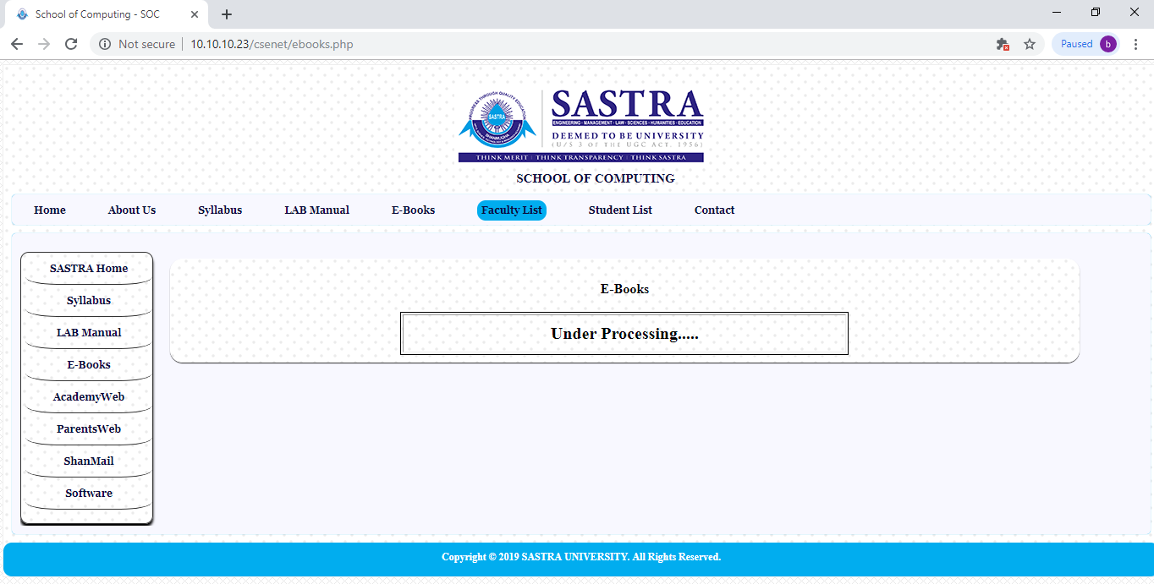
COMPETITOR WEB PAGE

Slide 7
FEATURES OVER EXISTING SYSTEM
Existing System <10.10.10.23/csenet> | Proposed System <Student Project>
Number of end users types (Students) | Number of end users types (Students)
Technical flaw (Always showing processing) | Technical improvement (Reference Books Notifications , QP)
Business loss (NA) | Business benefits (NA)
Tough(no manuals) | Easy (Help menu)
Feedback (No) Maintenance (No) | Feedback (Yes) Revision (allowed)

Slide 8
Scope of Proposed System (User View)
End User Type : Sastra University student
Domain : Education
Life span of the system : 4 years
Limitations : Works only when connected to internet.

Slide 9
Scope of Proposed System (System View)
System type : Webapp (Student Connect)
Technical Domain : File Retrieval
Hardware : Computer , Mobile
Software : HTML , CSS , PHP ,MySQL
Special Tool : NULL
Life span of the system : Up to next revision
Limitations : Works only on browsers

Slide 10
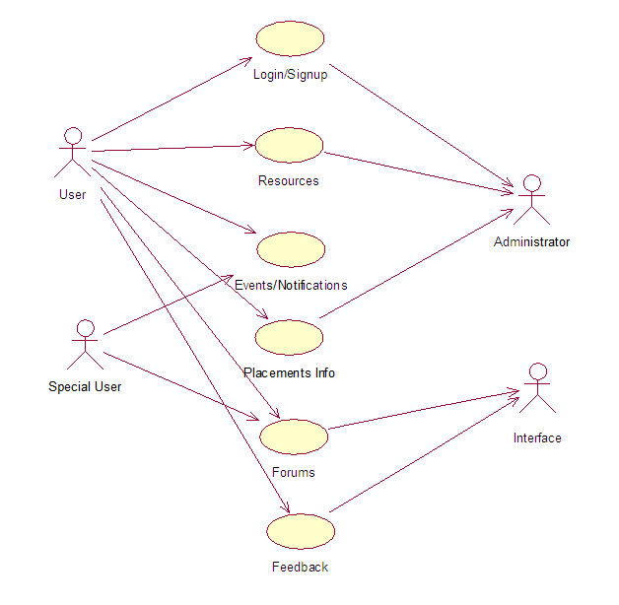
Use-Case Diagram

Slide 11
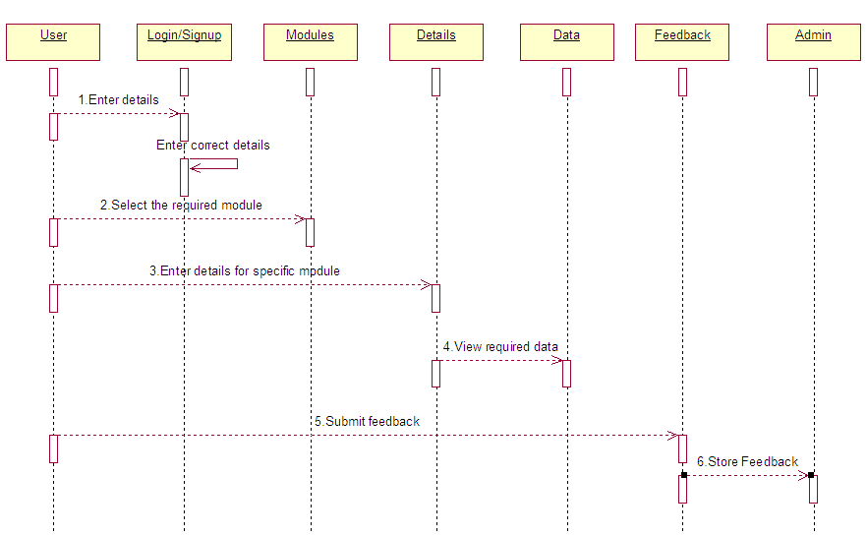
Sequence Diagram

Slide 12
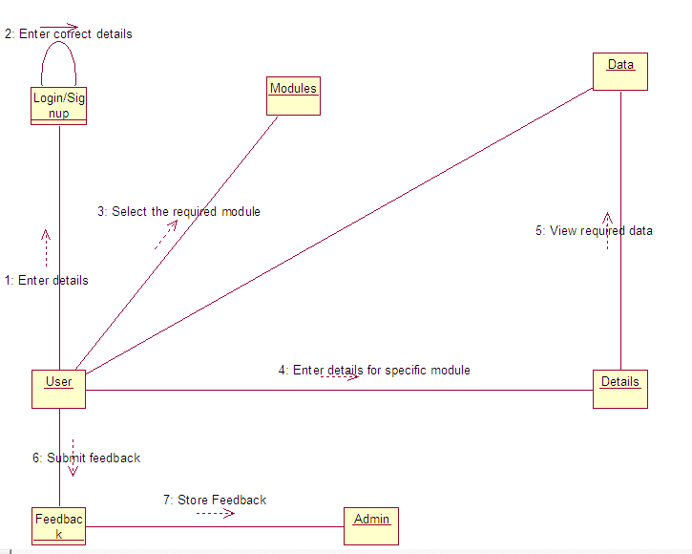
Collaboration Diagram

Slide 13
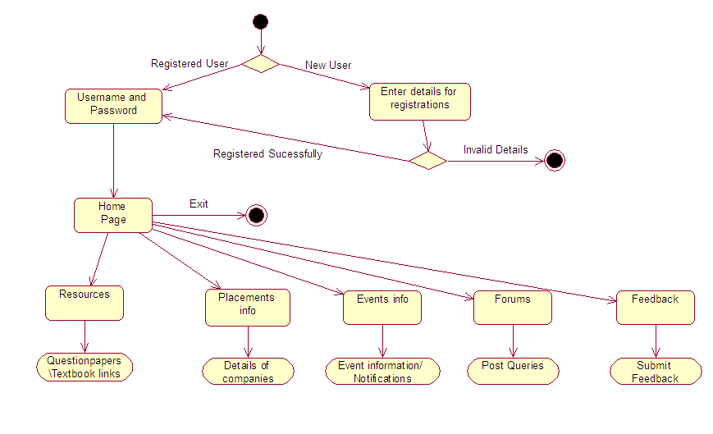
Activity Diagram

Slide 14
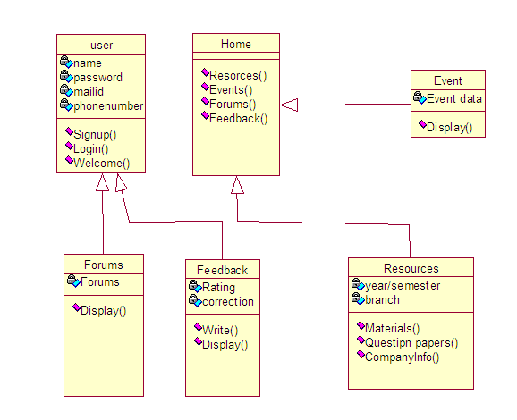
Class Diagram
N
1
1*

Slide 15
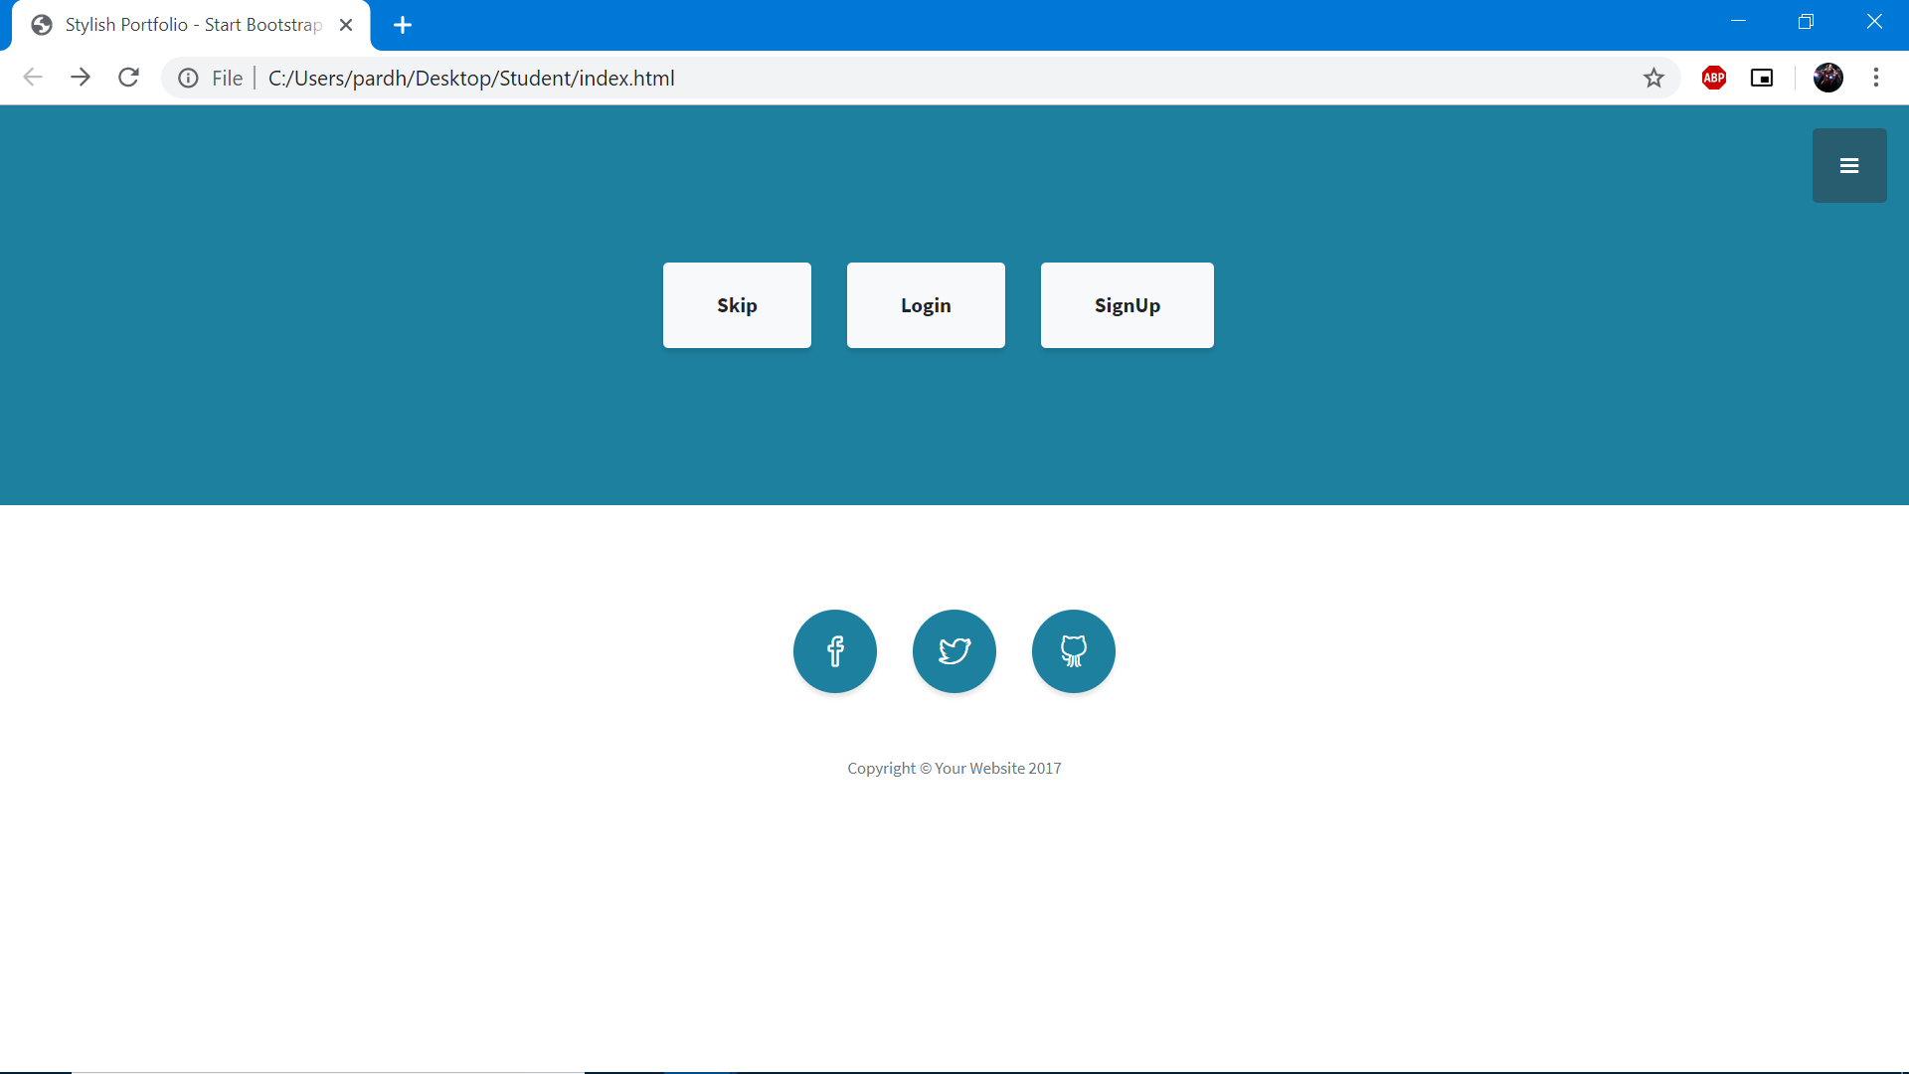
Front End Page

Slide 16
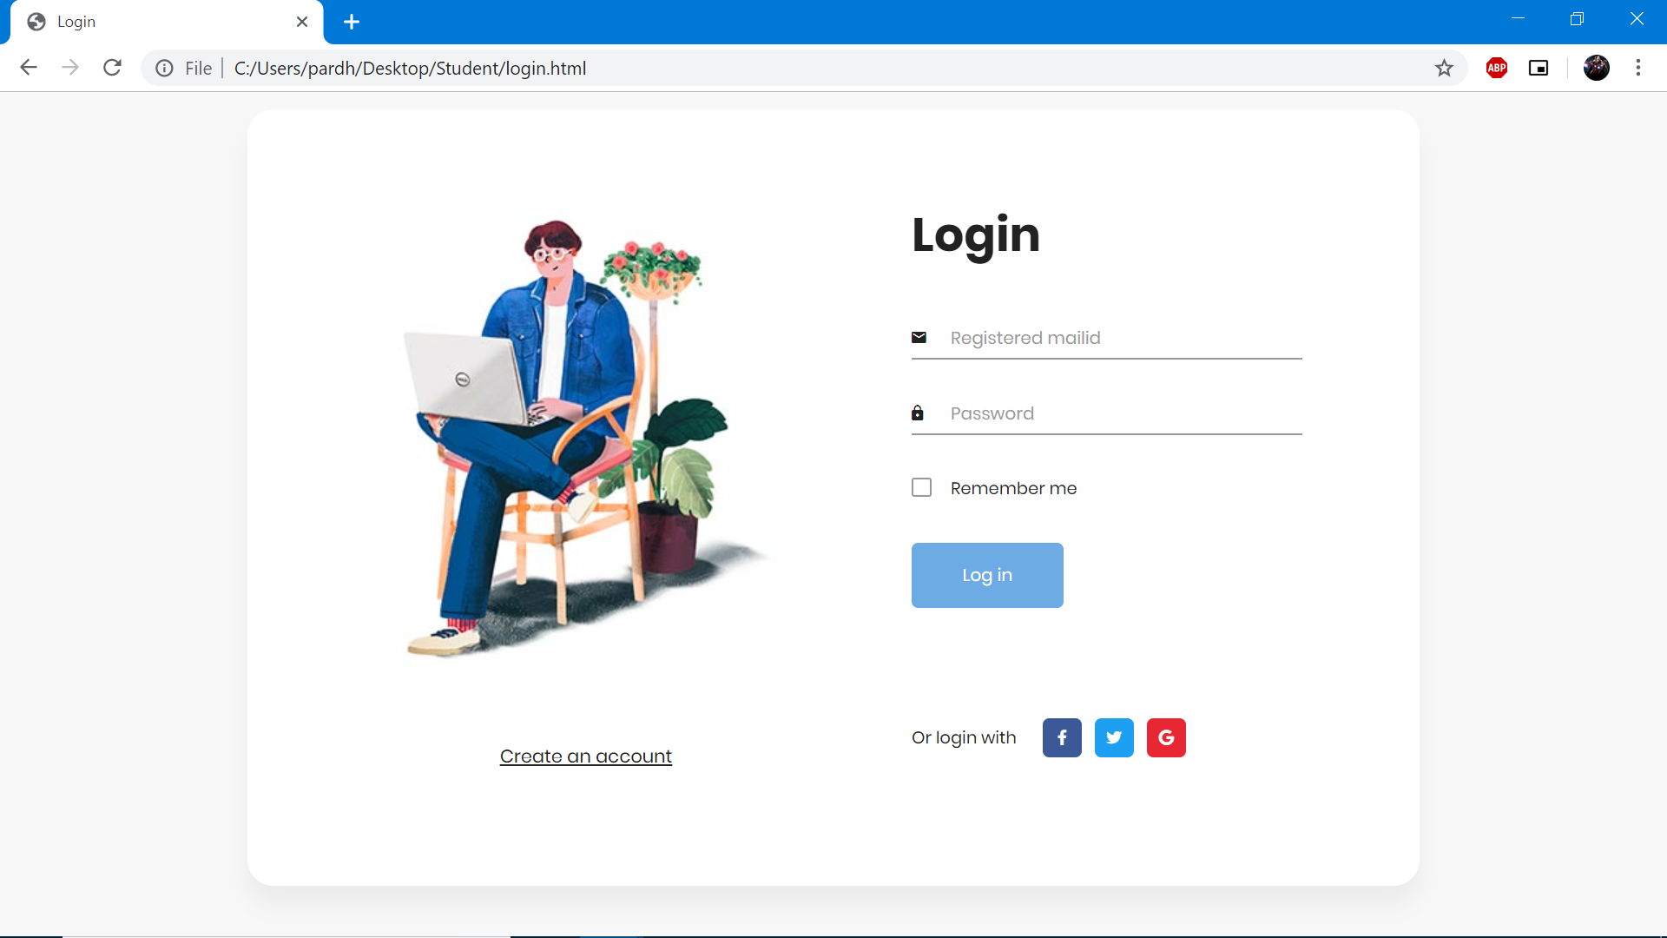
Login Page

Slide 17
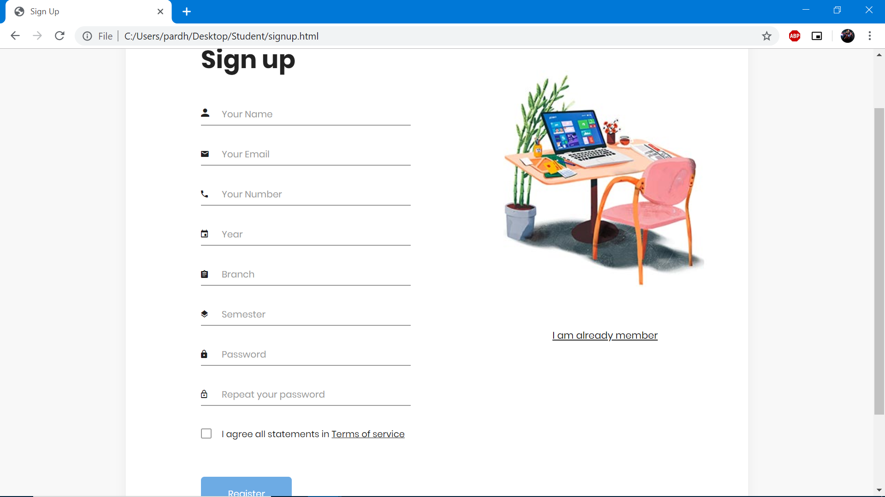
Sign Up Page

Slide 18
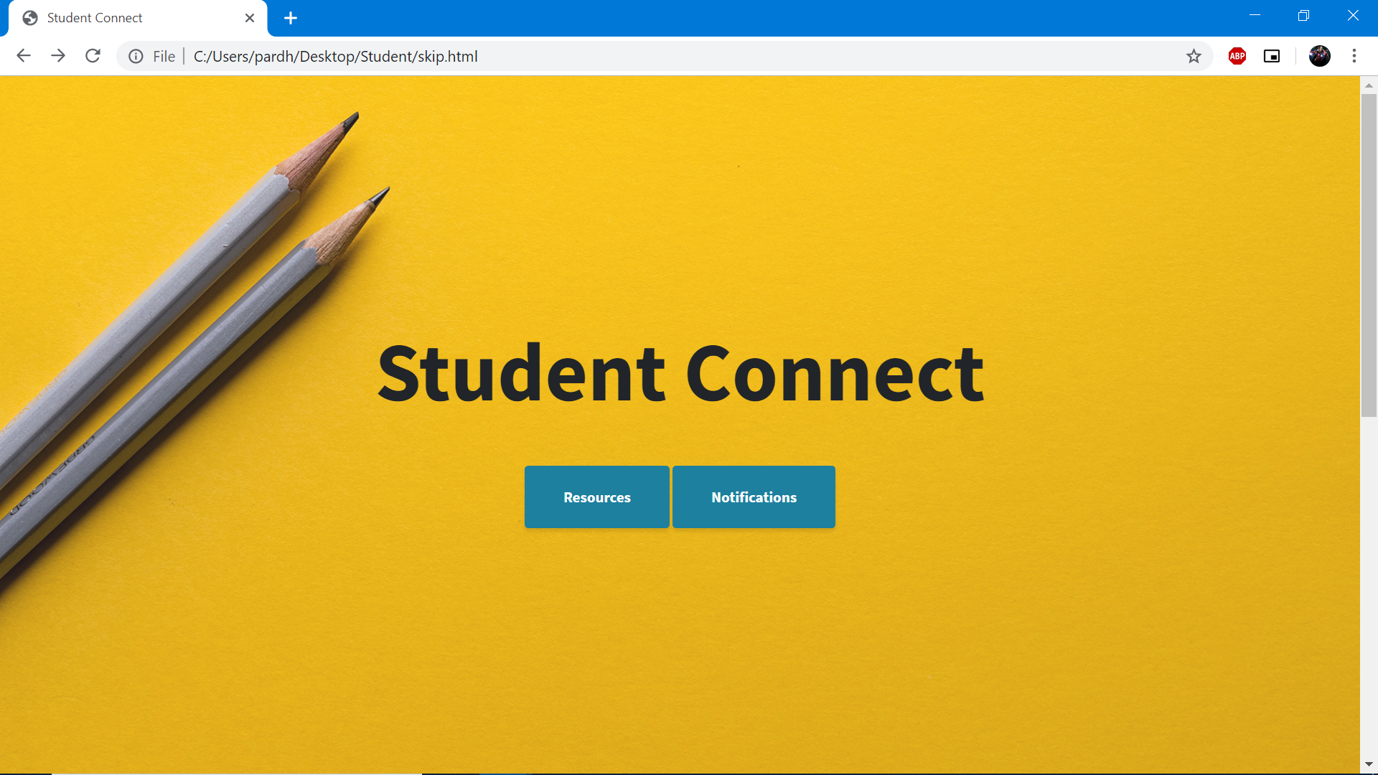
Home Page

Slide 19
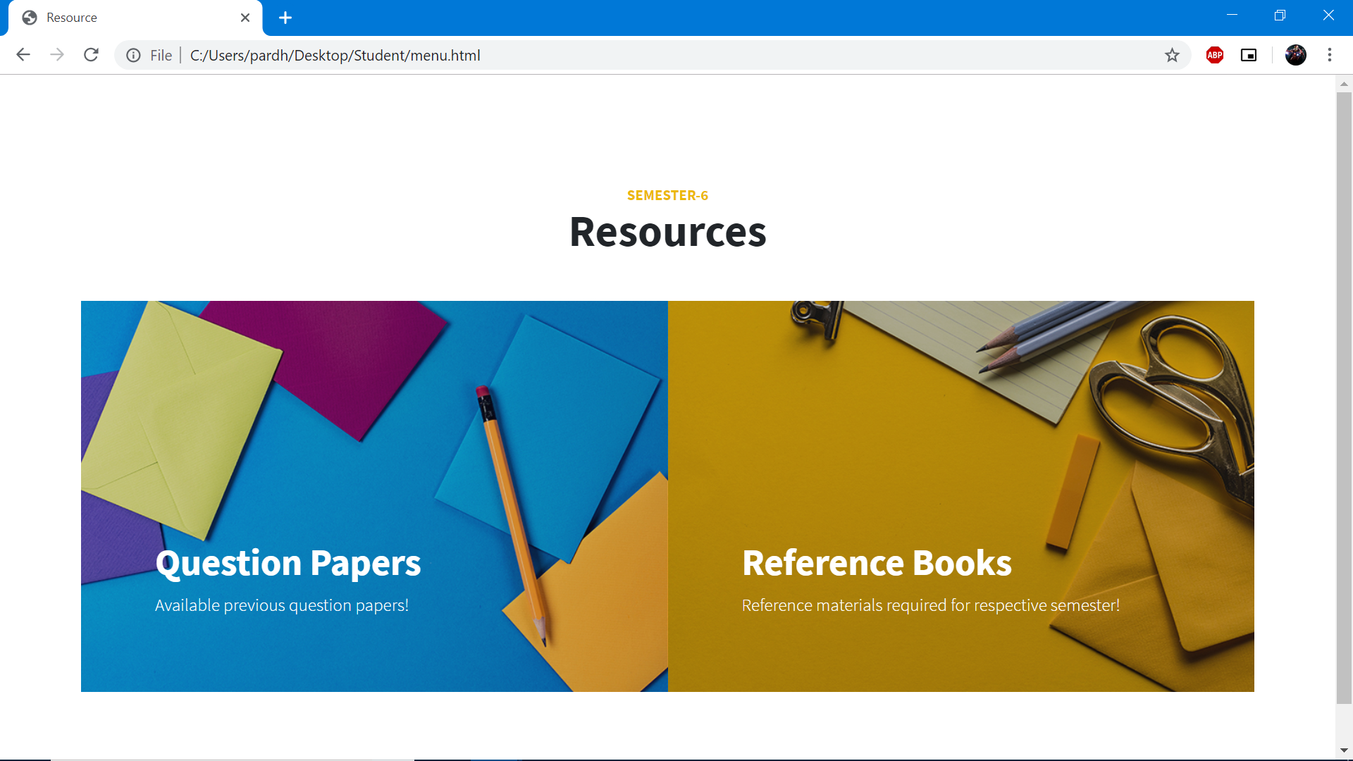
Menu Page

Slide 20
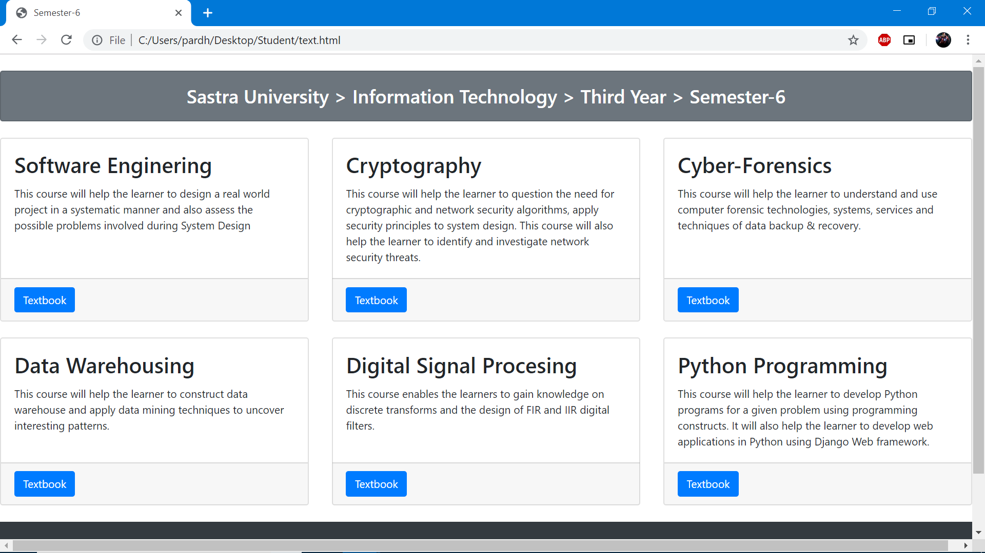
Documents Page

Slide 21
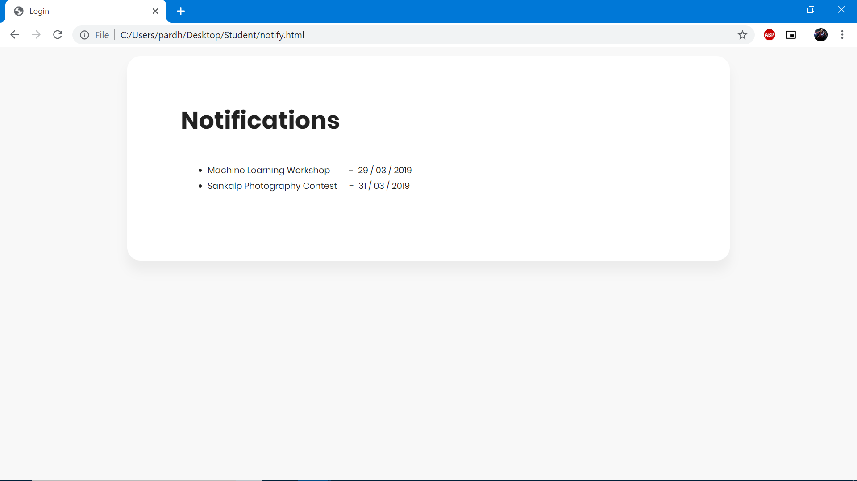
Events or Notifications

Slide 22
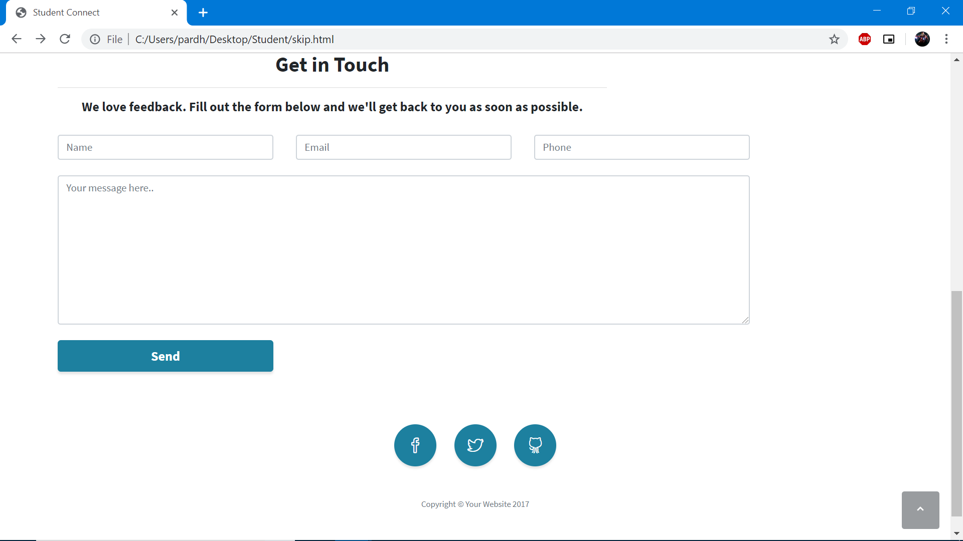
Feedback Page

Slide 23
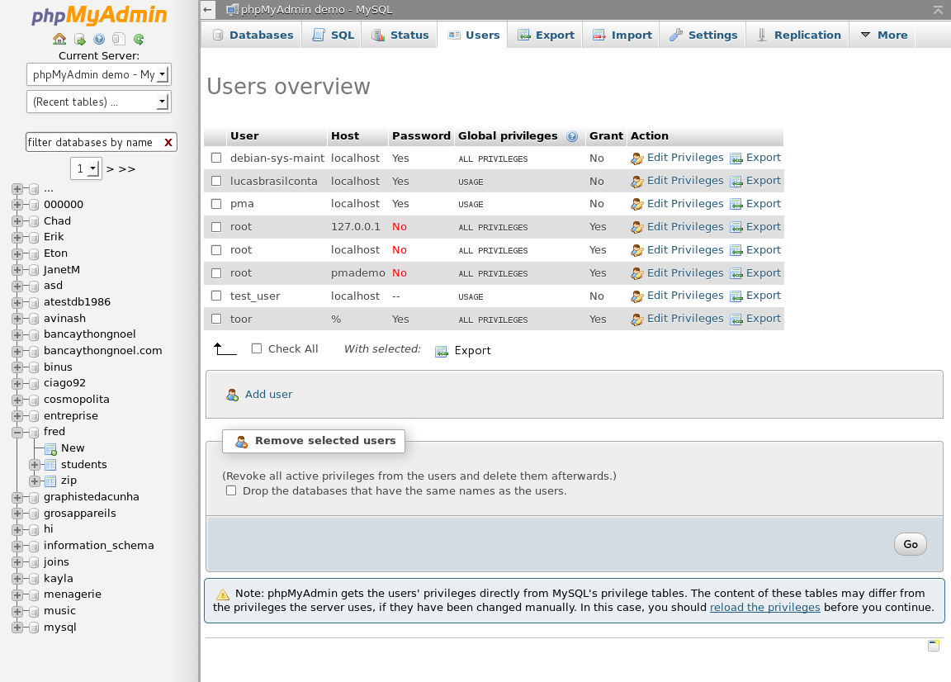
Back End Page

Slide 24
References
<Roger Pressman, Software Engineering, 6th edition>
<Jacobson, OOAD, Wiley publication>
<competitor web site URL>

